Slide 1

Pay Later, Spend More:
Klarna and the Hidden Risks of BNPL
presented by
CIS 3620 Group 5
Gyuhyoun (Evelyn) Kim, Omar Portillo-Carrillo, Riazul Raj, Ryan Reimers

Slide 2




Team Introduction
Gyuhyoun Kim
Ryan Reimers
Riazul Raj
Omar P.

Slide 3
Presentation Outline
Klarna and the BNPL model
- What Is Klarna?
- What Is BNPL?
- How the BNPL Model Works
Growth of BNPL in FinTech
- How Klarna Makes Money
- Why BNPL Became Popular
BNPL users and consumer benefits
- Who Uses BNPL?
- Consumer Benefits
Hidden financial and psychological risks
Merchant strategy and profitability
Apple checkout case study
Who Does BNPL Really Serve?
Conclusion
References

Slide 4
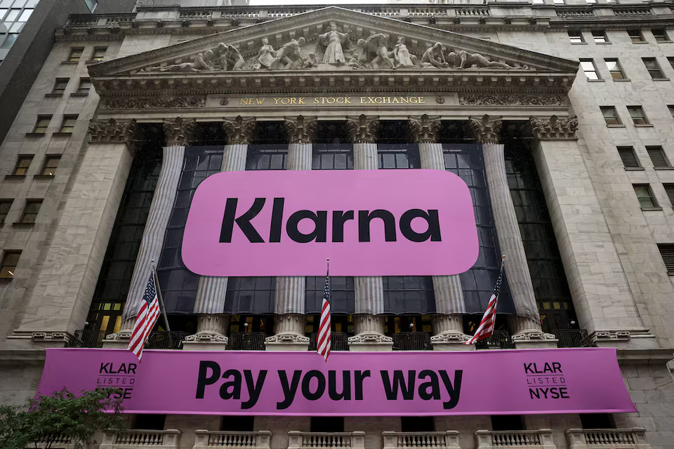
What Is Klarna?
Klarna
Swedish FinTech company founded in 2005
Provides flexible payment and checkout solutions
Best known for Buy Now, Pay Later services
Partners with online and in-store retailers
Listed on the NYSE in September 2025 under ticker KLAR
Source: Reuters, 2025. Photo: Brendan McDermid/Reuters.

Slide 5
What Is BNPL?
Buy Now, Pay Later
A type of installment loan that typically allows you to purchase something immediately with little or no initial payment and pay off the balance over four or fewer payments.
Source: CFPB
Notes:
BNPL stands for Buy Now, Pay Later.
It is a short-term installment payment option that allows consumers to purchase something immediately and pay for it later, usually in four or fewer payments.
This makes the purchase feel more manageable at checkout, because customers do not have to pay the full amount right away.
But it is important to remember that BNPL still works like a form of short-term credit.
Next, I will explain how this payment model works step by step.

Slide 6
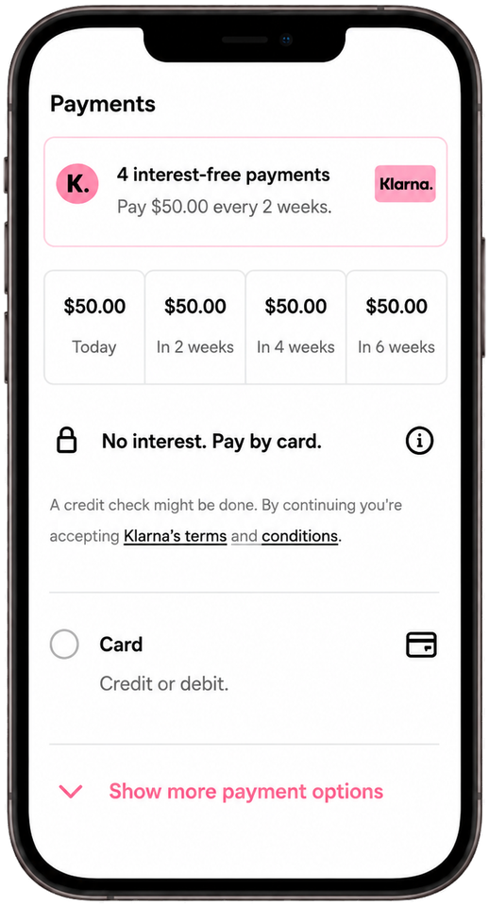
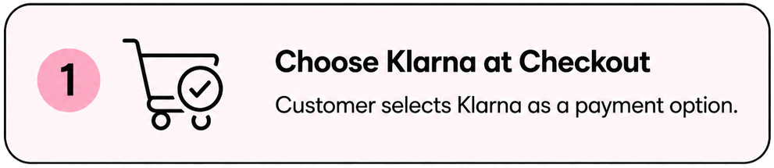
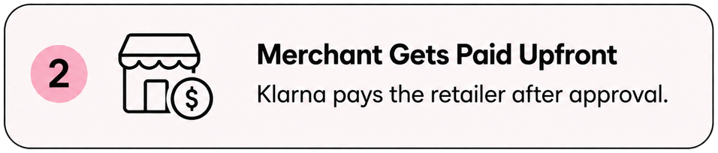
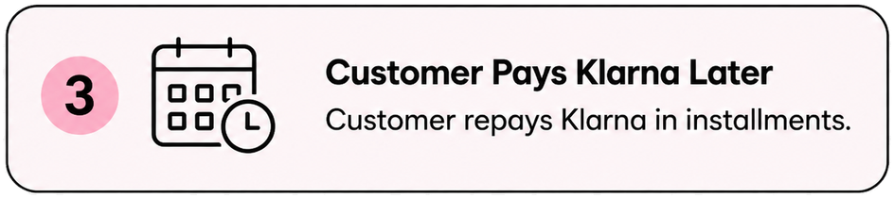
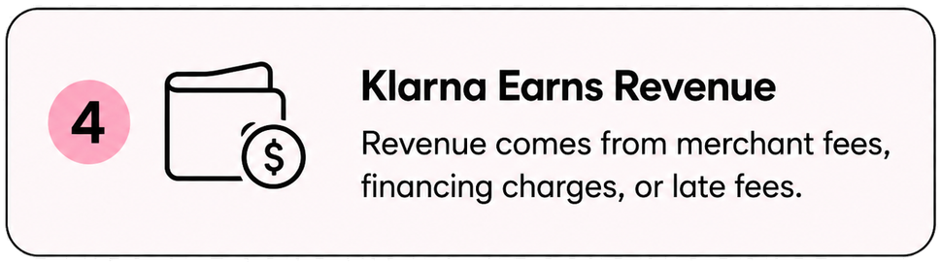
How the BNPL Model Works
Source: Klarna official website; CFPB

Slide 7
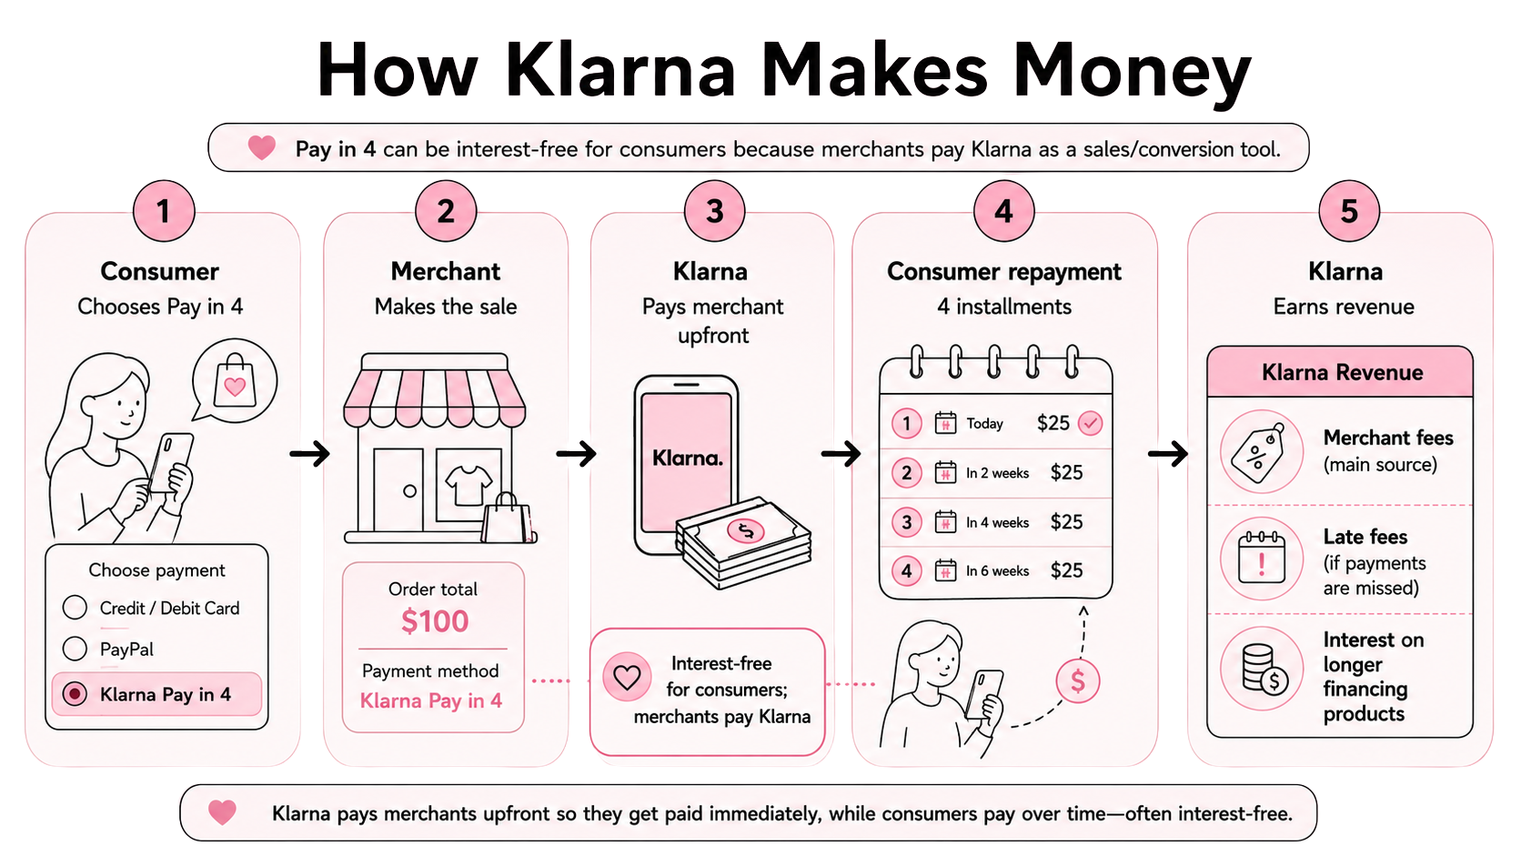
How Klarna Makes Money

Slide 8
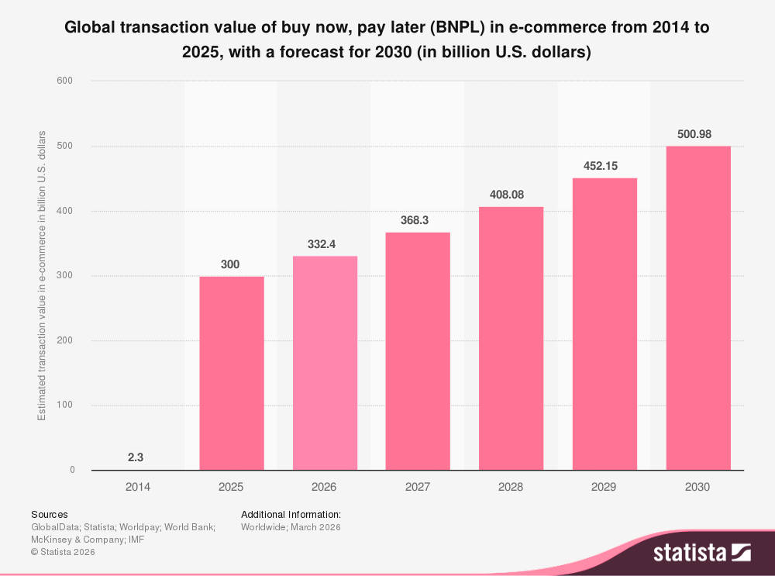
Why BNPL Became Popular
E-commerce acceleration: Online shopping made flexible checkout options more visible and convenient.
Credit card fatigue: BNPL feels more predictable than credit cards because payments are fixed, short-term, and often advertised as interest-free if paid on time.
Generational shift: Gen Z and Millennials are more open to app-based installment payments.
Affordability framing: Smaller payments reduce the psychological burden of the full purchase price.
Merchant strategy: Retailers use BNPL to increase sales, conversion rates, and average order value.
Source: Statista, based on Worldpay’s Global Payments Report 2026, p. 28.

Slide 9
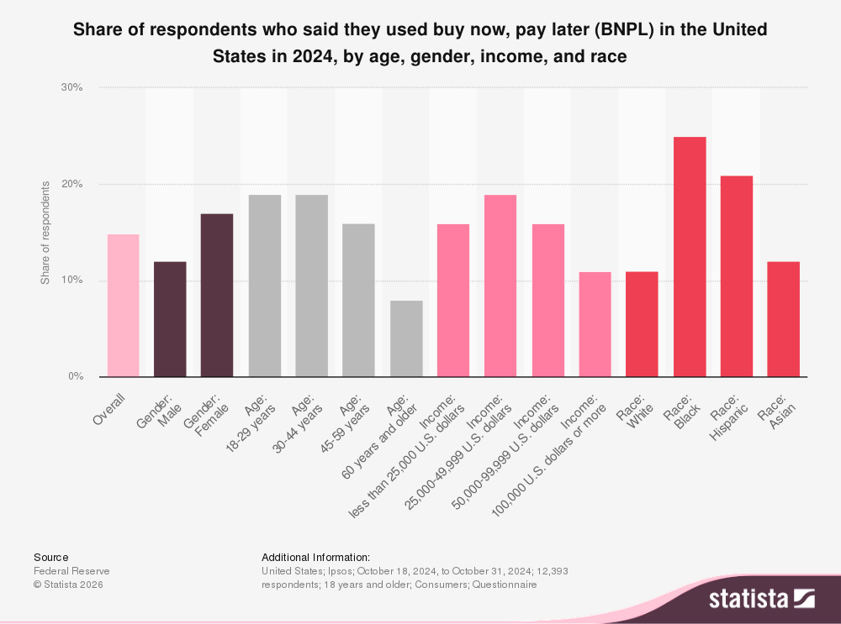
Who Uses BNPL?
BNPL usage is higher among younger consumers, especially ages 18–44.
Usage is stronger among low- and middle-income groups.
BNPL appeals to consumers seeking short-term payment flexibility.
BNPL users are diverse, but usage
varies by age, income, and race.
Source: Statista; Federal Reserve SHED 2024, p. 41.

Slide 10
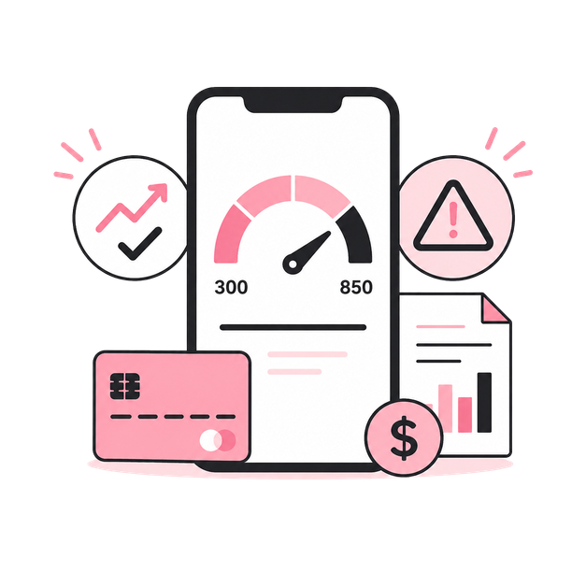
Consumer Benefits
General Benefits
Ability to split purchases into smaller payments
Often interest-free when paid on time
Lower upfront payment burden
Quick approval at checkout
More predictable short-term payments
Credit Score Considerations
Klarna Pay in 4 uses a soft credit check, which does not affect credit scores.
However, missed or late payments may lead to fees or further collection actions. Klarna says late fees may apply to missed Pay in 4 payments.
FICO introduced new credit scoring models that incorporate BNPL data, meaning BNPL repayment behavior may become more visible to lenders.
Responsible payments may help show positive behavior, but missed payments could create future credit risk.

Slide 11
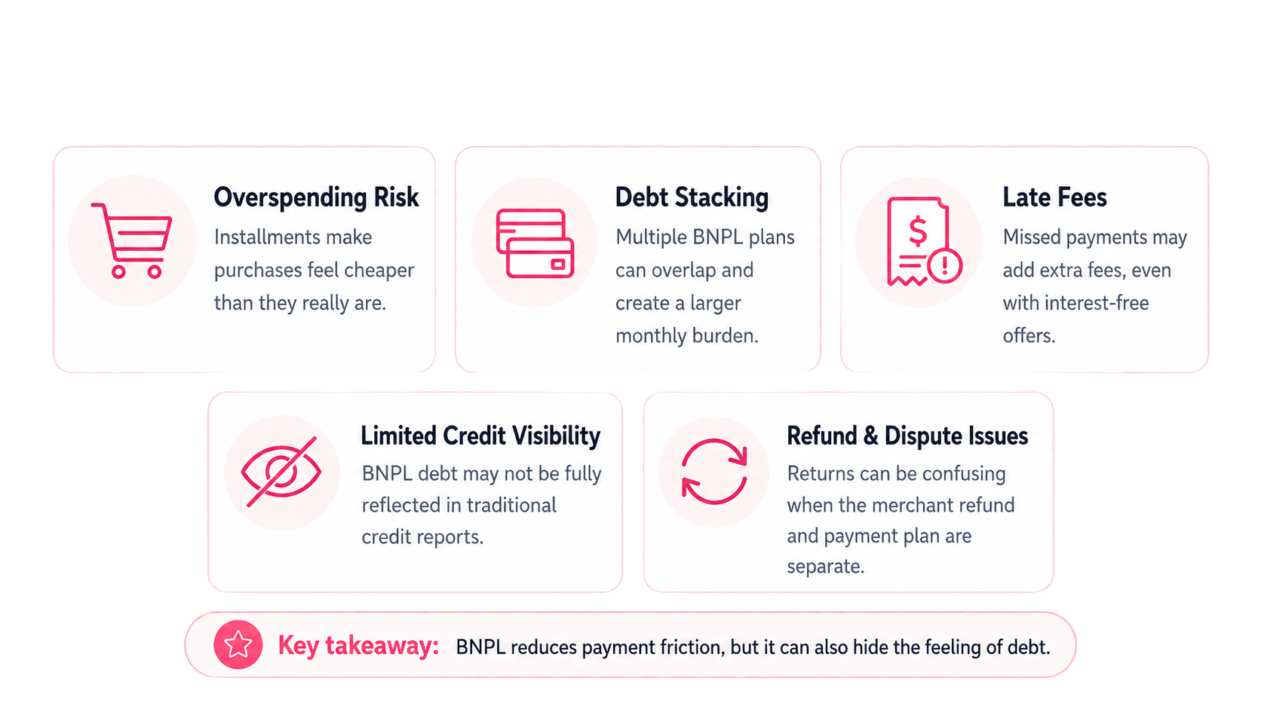
Hidden Financial Risks
Small payments can make debt less visible.

Slide 12
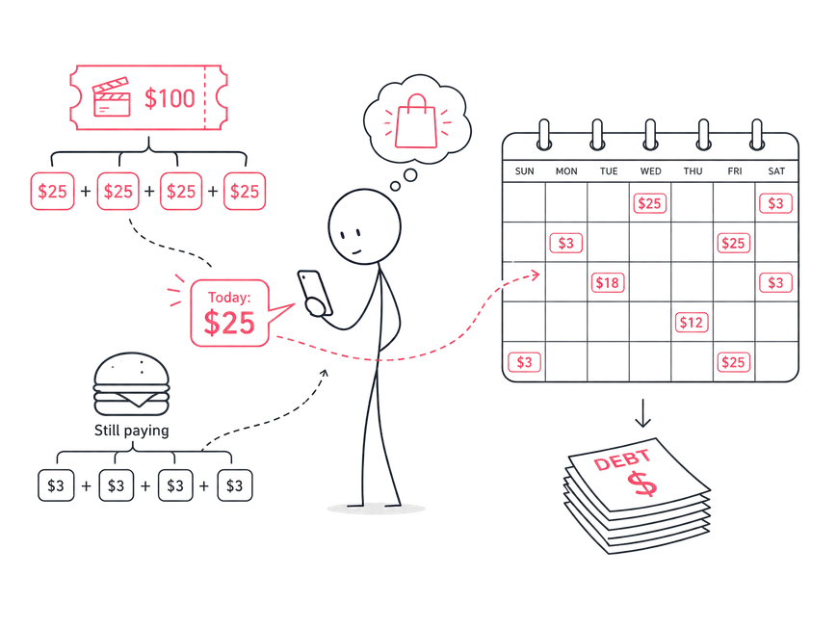
Psychological Effects of BNPL
Reduced pain of paying
A $100 purchase feels like “only $25 today,” making the cost
feel less serious.
Mental accounting effect
Consumers may treat each installment as a separate small
expense rather than one full purchase, making the total cost feel
less important.
Focus on installment, not total cost
Consumers may focus on the small payment amount rather
than the full purchase price.
Impulse buying becomes easier
BNPL removes the immediate barrier of paying in full at
checkout.
Debt feels less visible
Multiple payment plans can feel separate and harmless, even
when they create a larger total burden.
Credit risk is delayed or hidden
Unlike credit cards, BNPL repayment history may not always
help credit scores, while missed payments can still lead to fees
or financial stress. The Federal Reserve found that 24% of BNPL
users were late on a payment in 2024.
Source: Thaler, 1985 — Mental Accounting and Consumer Choice

Slide 13
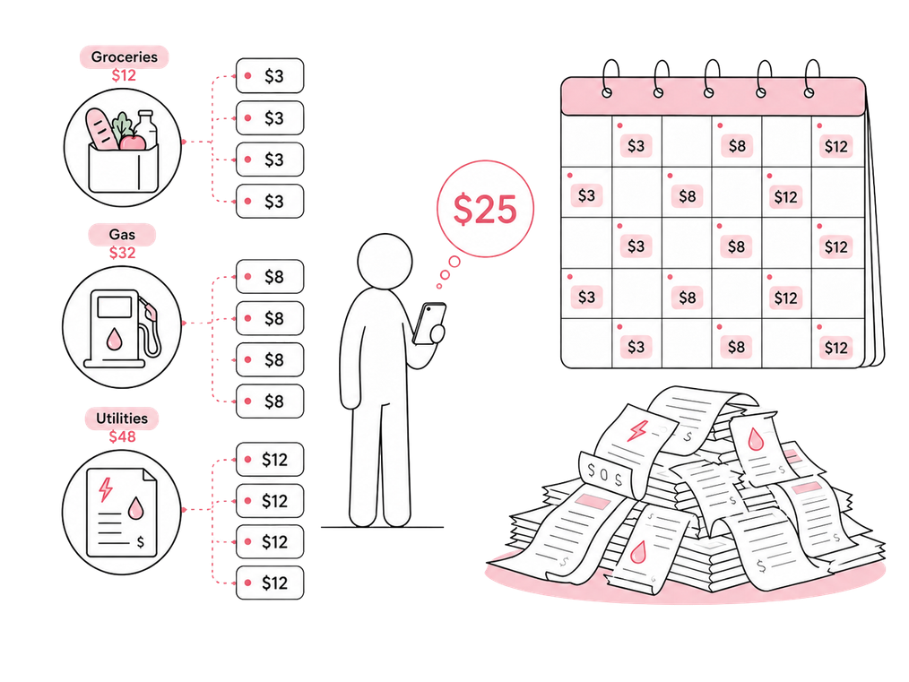
BNPL in Everyday Spending
BNPL is moving beyond big-ticket retail purchases into everyday necessities.
Spending on BNPL for gas, groceries, and utilities rose from $3.3M in 2019 to $229.2M in 2021.
In a recent survey, 29% of BNPL users used it for groceries, up from 14% two years ago; among Gen Z users, the number rises to 38%
Multiple small payments can scatter across the calendar, making total debt harder to track.
This makes BNPL feel less like borrowing and more like a normal way to shop.
Source: LendingTree, “BNPL Tracker: 47% of Users Late in Past Year,” Apr. 13, 2026

Slide 14
Why Merchants Use Klarna
Klarna as a Sales Tool
+20–30% Conversion
BNPL reduces checkout hesitation and helps customers complete purchases instead of abandoning carts. RBC
Capital Markets estimates BNPL can raise retail conversion rates by 20–30%.
~25% Higher AOV
Klarna’s on-site messaging shows smaller installment amounts near the product price or cart total, which can
increase perceived spending power and raise average order value by about 25%.
Younger Customer Acquisition
Macy’s reported that 40% of Klarna shoppers were new to Macy’s, and 45% were under 40, showing how BNPL
can attract younger shoppers.
Upfront Payment, Lower Credit Risk
Merchants get paid upfront, while Klarna manages customer repayment and assumes credit/fraud risk.
Scale Advantage
Klarna surpassed 1 million merchants globally in 2026, including brands such as Uber, H&M, Sephora, Macy’s,
Nike, and Airbnb.

Slide 15
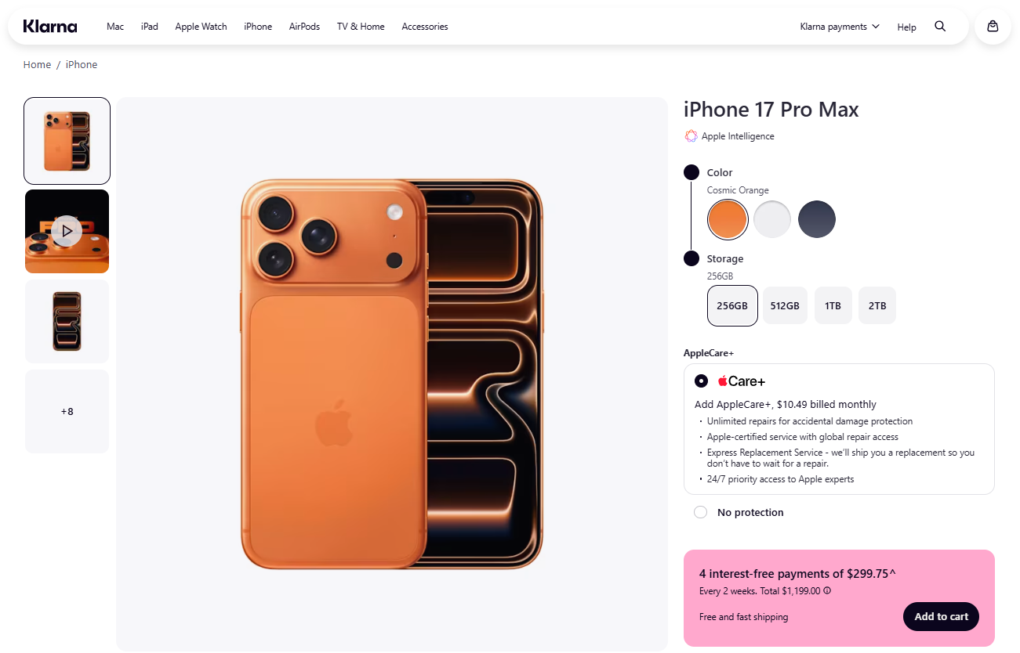
Apple Pay Case Study: Klarna Inside Checkout
Klarna as More Than a Payment Option
Klarna shows Apple products directly on its own shopping platform.
A $1,199 iPhone is presented as 4 interest-free payments of $299.75.
The product is not cheaper, but the smaller payment amount makes it feel more affordable.
Klarna does not just process the
payment; it also shapes how the
price is presented to shoppers.
Source: Klarna Apple Storefront, iPhone 17 Pro Max product page.

Slide 16
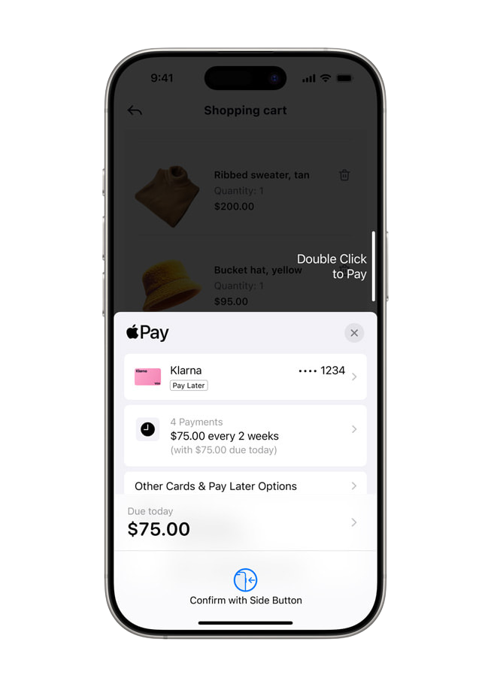
Apple Product Case Study: Pay-in-4 Framing
Framing Effect at Checkout
Full price: $300 → Klarna framing: “$75 every 2 weeks”
The same purchase feels smaller when it is broken into installments.
Seamless Exposure
Klarna appears directly inside Apple Pay’s checkout flow, so
consumers can see BNPL without leaving the payment screen.
Visible at the Moment of Purchase
Apple Pay places installment options inside a familiar payment
experience, making BNPL feel like a normal checkout choice.
Mainstream Reach
Apple Pay is used by hundreds of millions of consumers across 78
markets, showing that BNPL is moving into mainstream payment
infrastructure.
Source: Apple Newsroom, “Apple celebrates 10 years of Apple Pay” (2024).

Slide 17
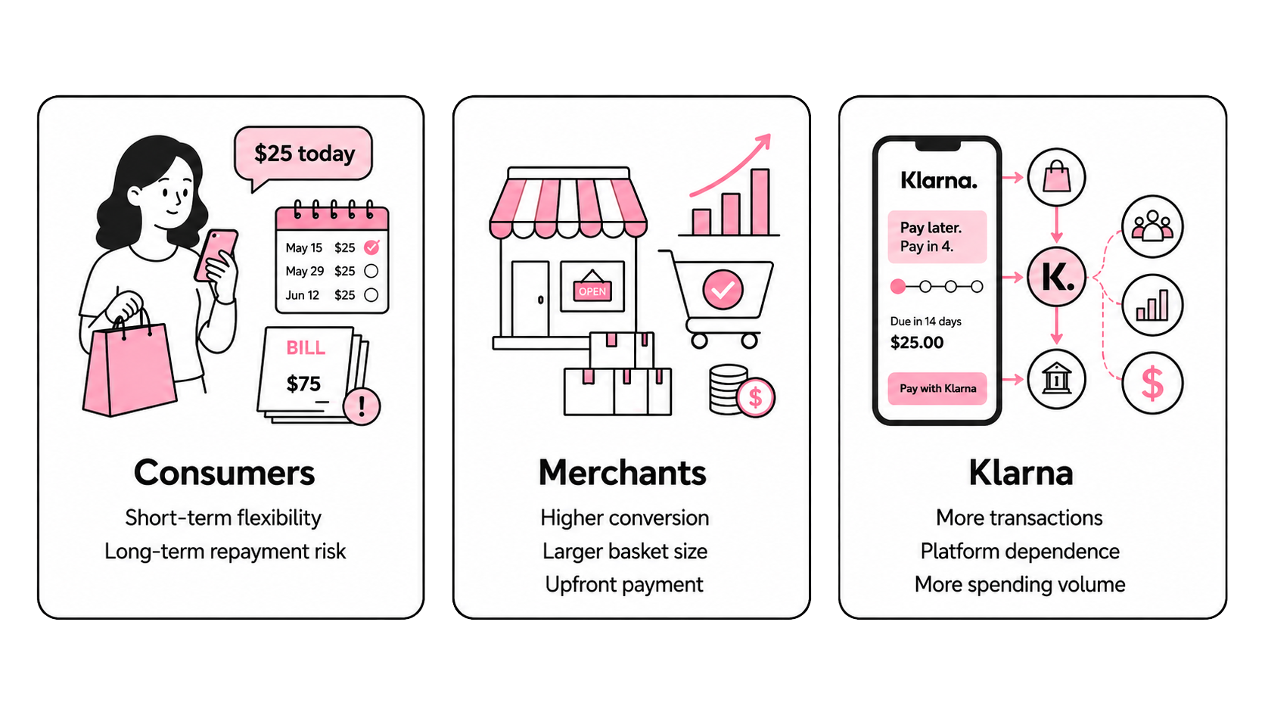
Who Does BNPL Really Serve?

Slide 18
Conclusion
BNPL is not just a payment method.
It is a spending design.

Slide 19
Thank you!

Slide 20
Q & A

Slide 21
References
Apple. (2024, October). Apple celebrates 10 years of Apple Pay. Apple Newsroom. https://www.apple.com/newsroom/2024/10/apple-celebrates-10-years-of-apple-pay/
Batdorf, E. (2025, December 19). Pros and cons of buy now, pay later. Experian. https://www.experian.com/blogs/ask-experian/pros-cons-of-buy-now-pay-later/
Basil, A. K., & Biswas, P. (2025, September 10). Klarna valued at nearly $20 billion as shares jump in NYSE debut. Reuters. https://www.reuters.com/business/finance/klarna-valued-nearly-20-billion-shares-jump-nyse-debut-2025-09-10/
Business Wire. (2025, February 27). More consumers using buy now, pay later, J.D. Power finds. https://www.businesswire.com/news/home/20250227435262/en/More-Consumers-Using-Buy-Now-Pay-Later-J.D.-Power-Finds
Consumer Financial Protection Bureau. (n.d.). What is a buy now, pay later (BNPL) loan? Retrieved May 10, 2026, from https://www.consumerfinance.gov/ask-cfpb/what-is-a-buy-now-pay-later-bnpl-loan-en-2119/
Consumer Financial Protection Bureau. (2022, September). Buy now, pay later: Market trends and consumer impacts. https://files.consumerfinance.gov/f/documents/cfpb_buy-now-pay-later-market-trends-consumer-impacts_report_2022-09.pdf
Federal Reserve. (2025, May 28). Share of respondents who said they used buy now, pay later (BNPL) in the United States in 2024, by age, gender, income, and race [Graph]. In Statista. Retrieved May 10, 2026, from https://www.statista.com/statistics/1421852/bnpl-user-demographics-usa/
Federal Reserve Bank of Boston. (2024). Buy now, pay later: Who uses it and why. https://www.bostonfed.org/publications/current-policy-perspectives/2024/buy-now-pay-later-who-uses-it-why.aspx
Harvard Business Review. (2024, November). Research: How "buy now, pay later" is changing consumer spending. https://hbr.org/2024/11/research-how-buy-now-pay-later-is-changing-consumer-spending
Hermann, J., & Gupta, A. (2023, May 18). How Klarna grows: Building the shopping destination of the future. How They Grow. https://www.howtheygrow.co/p/how-klarna-grows-building-the-shopping
Klarna. (n.d.-a). Klarna. Retrieved May 10, 2026, from https://www.klarna.com/us/
Klarna. (n.d.-b). iPhone 17 Pro Max. Klarna Store. Retrieved May 10, 2026, from https://store.klarna.com/us/applefromklarna/p/iphone-17-pro-max/cosmic-orange-256gb/
Klarna. (n.d.-c). Understand Klarna. Klarna Group plc. Retrieved May 10, 2026, from https://investors.klarna.com/understand-klarna/default.aspx
Klarna Group plc. (2025, March 14). Form F-1 registration statement. U.S. Securities and Exchange Commission. https://www.sec.gov/Archives/edgar/data/2003292/000162828025012824/klarnagroupplcf-1.htm
LendingTree. (2026, April 13). Nearly half of BNPL users have paid late in the past year, up for a second straight year. https://www.lendingtree.com/personal/buy-now-pay-later-loan-statistics/
Shevlin, R. (2022, April 10). Breakout: Apple's plan to pump up Apple Card and Apple Pay and win the payments war. Forbes. https://www.forbes.com/sites/ronshevlin/2022/04/10/breakout-apples-plan-to-pump-up-apple-card-and-apple-pay-and-win-the-payments-war/
Statista & Worldpay. (2026, March 27). Global transaction value of buy now, pay later (BNPL) in e-commerce from 2014 to 2025, with a forecast for 2030 (in billion U.S. dollars) [Graph]. In Statista. Retrieved May 10, 2026, from https://www.statista.com/statistics/1311122/global-bnpl-market-value-forecast/

Slide 22
Who Does BNPL Really Serve?
Consumer Benefit: Partially True
BNPL offers short-term flexibility and often interest-free payments.
But 41% of BNPL users reported a late payment in 2025.
As BNPL data enters new credit scoring models, missed payments may become harder to ignore.
Merchant Benefit: Structurally Stronger
Merchants gain higher conversion, larger basket size, and upfront payment.
Klarna says merchants are paid upfront while Klarna manages credit and fraud risk.
The business model works best when BNPL encourages more completed purchases.
Behavioral Reality
Pay-in-4 makes the price feel smaller at checkout.
Multiple loans can stack up quietly. CFPB found 63% of BNPL borrowers had simultaneous loans.
BNPL is marketed as flexibility, but its design also encourages spending.
BNPL helps consumers manage payments, but it serves merchants more directly by reducing checkout hesitation and increasing spending.

